Slide 1
Porting Zephyr RTOS

Slide 2
What is Zephyr?

Slide 3
Introduction:
Zephyr OS is based on small footprint kernel design for use on resource constrained.
Zephyr kernel support multiple architectures i.e RISC-V (32- and 64-bit).
For platforms without MMU/MPU, it supports combining application specific code with a custom kernel to create a monolithic image.
Information from device tree is used to create the application image.

Slide 4
Kernel Services:
Every Zephyr application based on zephyr kernel.
The configurable nature of kernel allows only those features needed your application making it ideal for systems with limited amounts of memory (as little as 2 KB!).
Zephyr kernel supports a variety of device drivers depends on the board and supported generic type API.

Slide 5
Build and Configuration:
The Zephyr build process can be divided into two main phases: a configuration phase and a build phase.
The configuration phase begins when the user generate a build system, specifying a board target and a source application directory.
west build -b aws_fpga samples/printk/

Slide 6
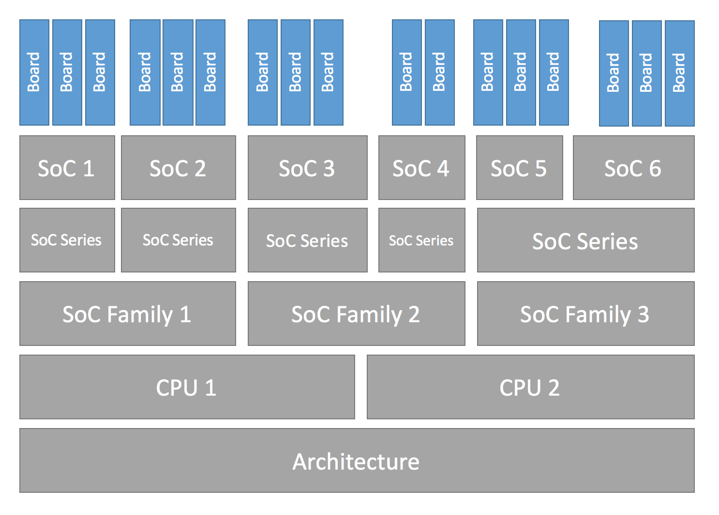
Configuration Hierarchy:

Slide 7
Devicetree
*.dts and *.dtsi files are collected from the target’s architecture, SoC, board, and application directories then included via the C preprocessor. The preprocessor output is placed in build/zephyr/zephyr.dts.pre.
Kconfig
Kconfig files define available configuration options for for the target architecture, SoC, board, and application.
AWS-FPGA
RISC-V
(32- or 64-bit)
I,M,A,F
PrintK
AWS
Configuration

Slide 8
Build Phase:
The build phase can be divided, into three stages: the pre-build, final binary, and post-processing.
Pre-build occurs before any source files are compiled, because during this phase header files used by the source files are generated.
Final binary from the previous stage is incomplete. The link from the previous stage is repeated, this time with the missing pieces populated.
Post processing Finally, if necessary, the completed kernel is converted from ELF to the format expected by the loader and/or flash tool required by the target. This is accomplished in a straightforward manner with objdump.

Slide 9
What have done:
Create our own application directory in samples/printk. samples/printk/main.c.
Create our custom board to initialize SoC by writing own kconfig and dts files. boards/riscv/aws_fpga.
Then write the aws_fpga.dtsi(include) file for specifying hardware specification and add it on board configuration file.
Create an SoC directory on soc/riscv/riscv-privilage/aws/ and writing all soc related configuration on it.

Slide 10
What have done:
For CPU architecture customize .isa and .core files. arch/riscv/*.core *isa in which defining IMA extension for CPU.
So in that manner we will define the right architecture for gcc compiler like -march=rv64ima.
Reduce the kernel footprint for application that do not runtime configuration. I.e driver/serial/Kconfig disable runtime uart configuration.

Slide 11
Expected Output:
First build the application with zephyr kernel. We get zephyr.elf and .lst. By using objcopy extract verilog hex from .elf file.
Generated hex will be dumped on DDR-A from shell DMA port.
Hydra start fetching kernel from DDR.
We have two peripheral UART and BRAM to check the expected output from our main application.

Slide 12
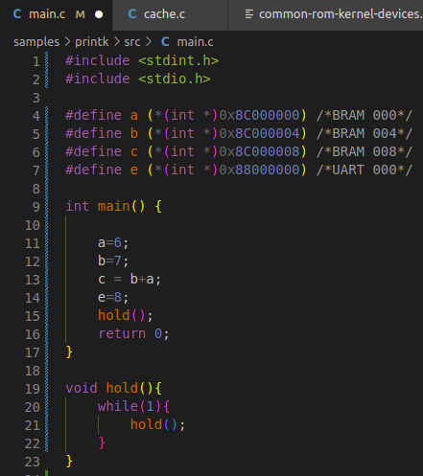
Application:
Writing values of a,b and c in BRAM.
Value of e write on the address of UART.
Using runtime driver all peripheral are tested.
Uart to uart and hydra to uart testing is done using runtime drivers and assembly.

Slide 13
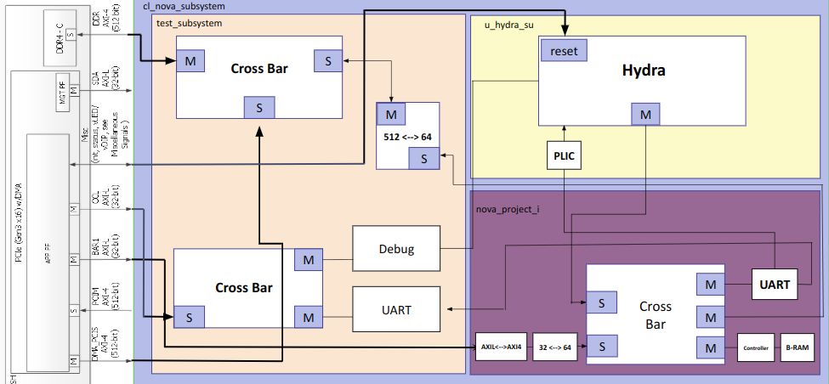
Big Picture

Slide 14
Thank You

